Slide 1
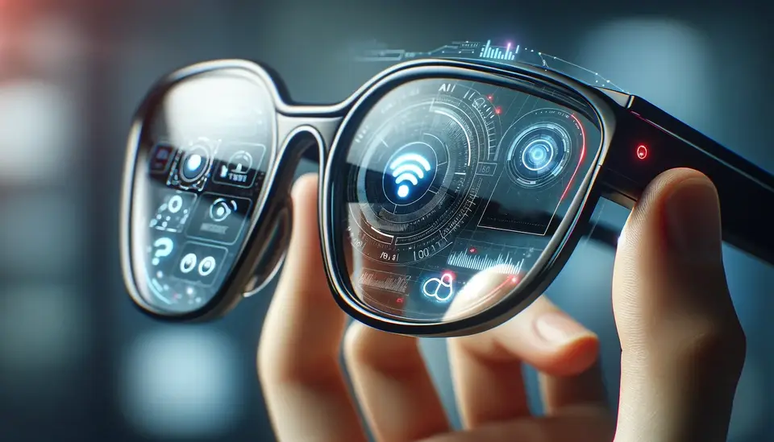

Wearable Computer
DEVIBA INSTITUTE OF COMPUTER APPLICATON, SABARGAM
Guided By
Prof.Dhruti Patel
Submited By
Kumhar Harshad(244)

Slide 2
INDEX
1.Introduction of Wearable Computer
2. History Of wearable Computer
3.Types Of Wearable Computers
4. Applications of Wearable Computers
5. How it works
6. Aims of wearable Computer
7. Advantages and Dis-Advantages
8. Features of Wearable Computer
9. Conclusion
10. Reference Sites
NEXT
PRIVIEW

Slide 3
1.Introduction of Wearable Computer
PRIVIEW
NEXT
HOME

Slide 4
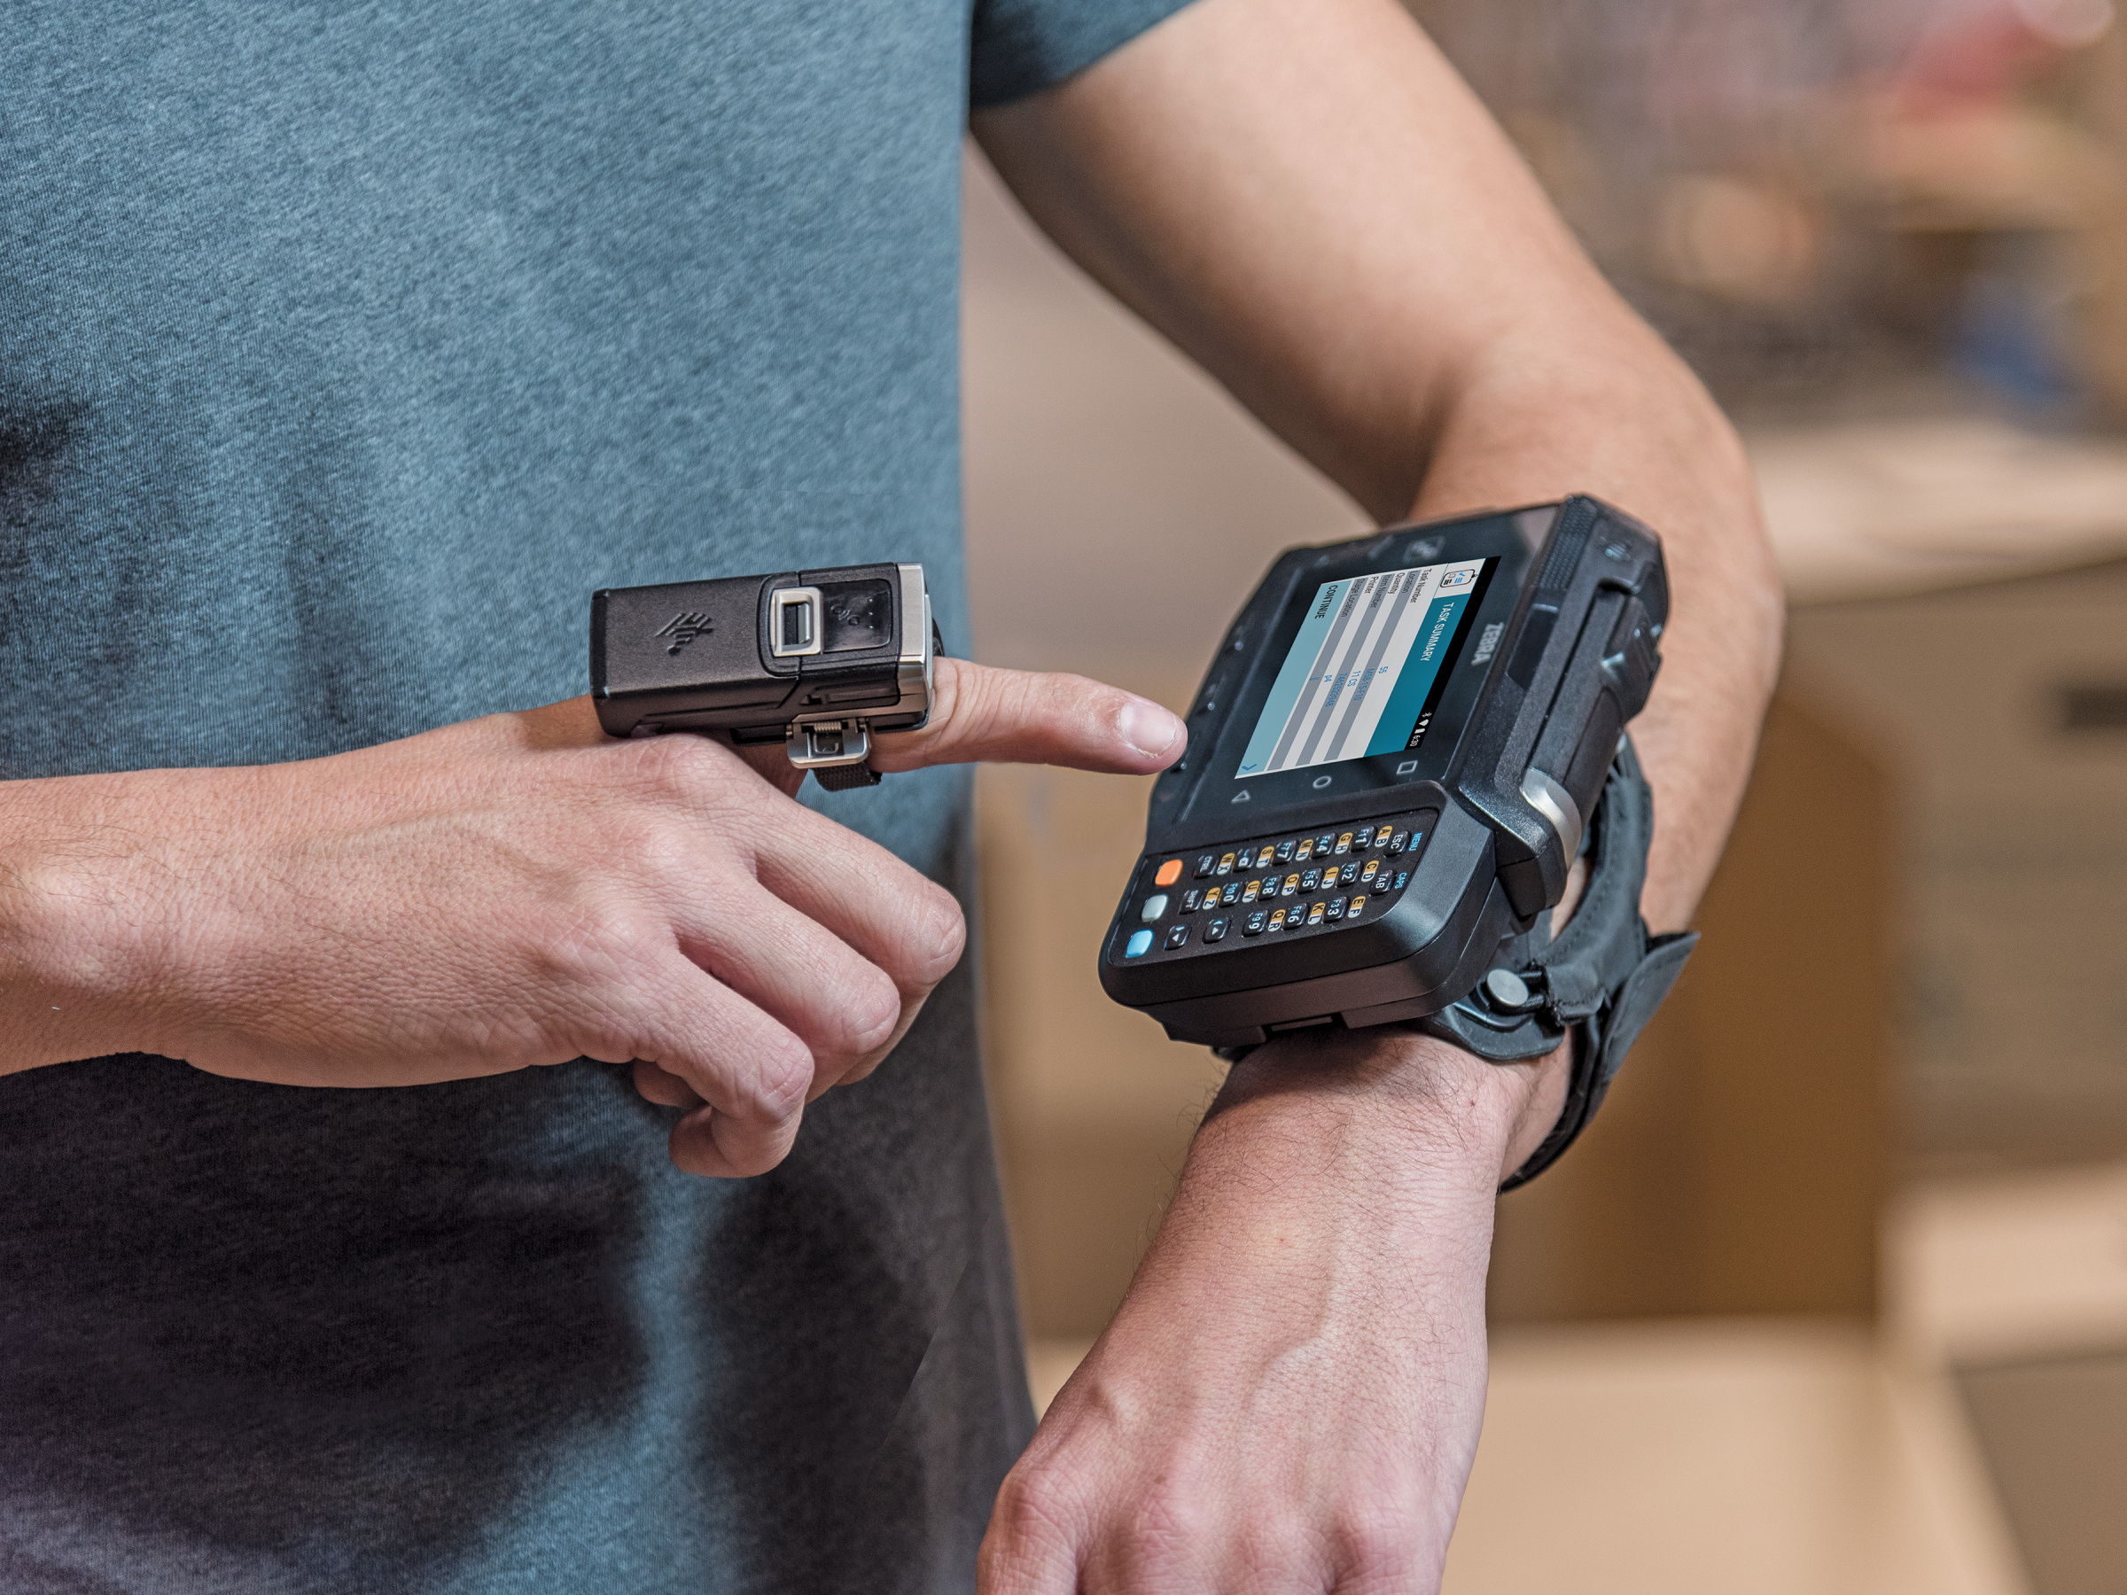
s
A small portable computer designed to be worn on the body during use.
A wearable computer is a computer that the user controls.
A wearable computer looks like a simple gadget.
The other name of wearable computer is Computer Clothing
It providing real-time information.
PRIVIEW
NEXT
HOME

Slide 5
2.History of Wearable Computer
PRIVIEW
NEXT
HOME

Slide 6
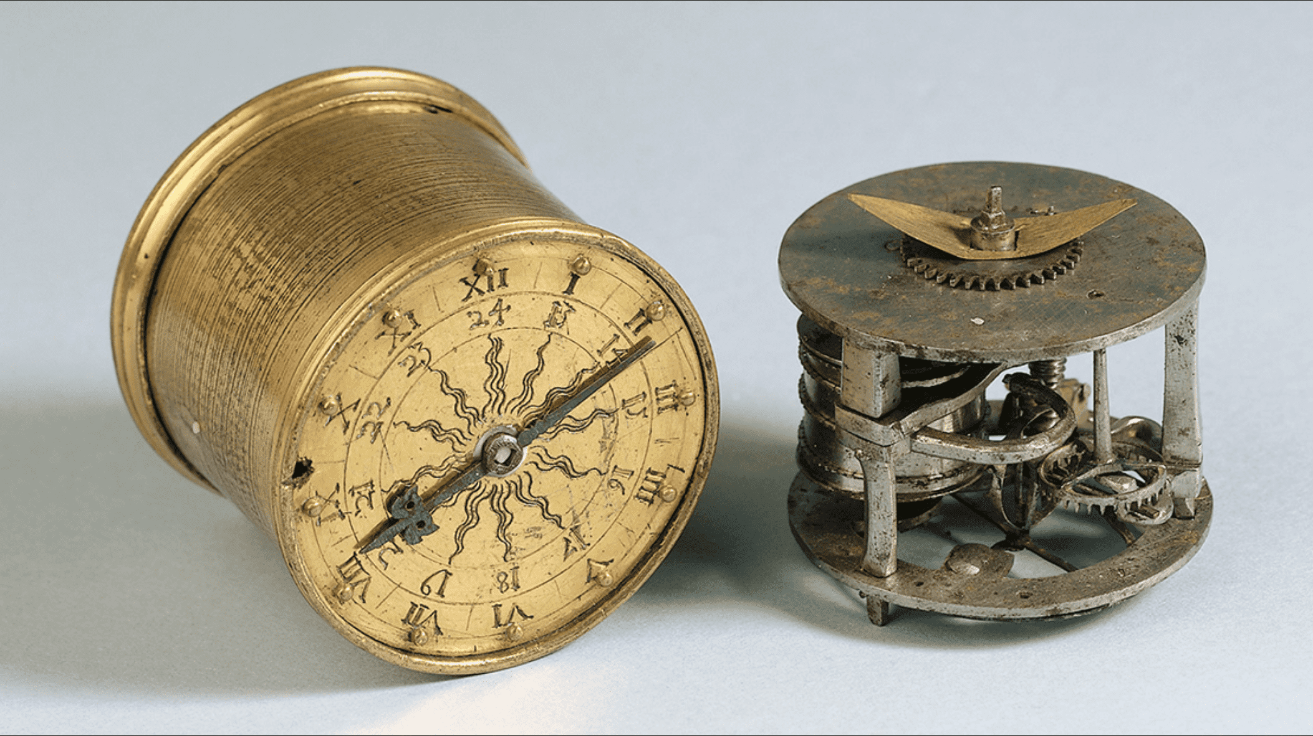
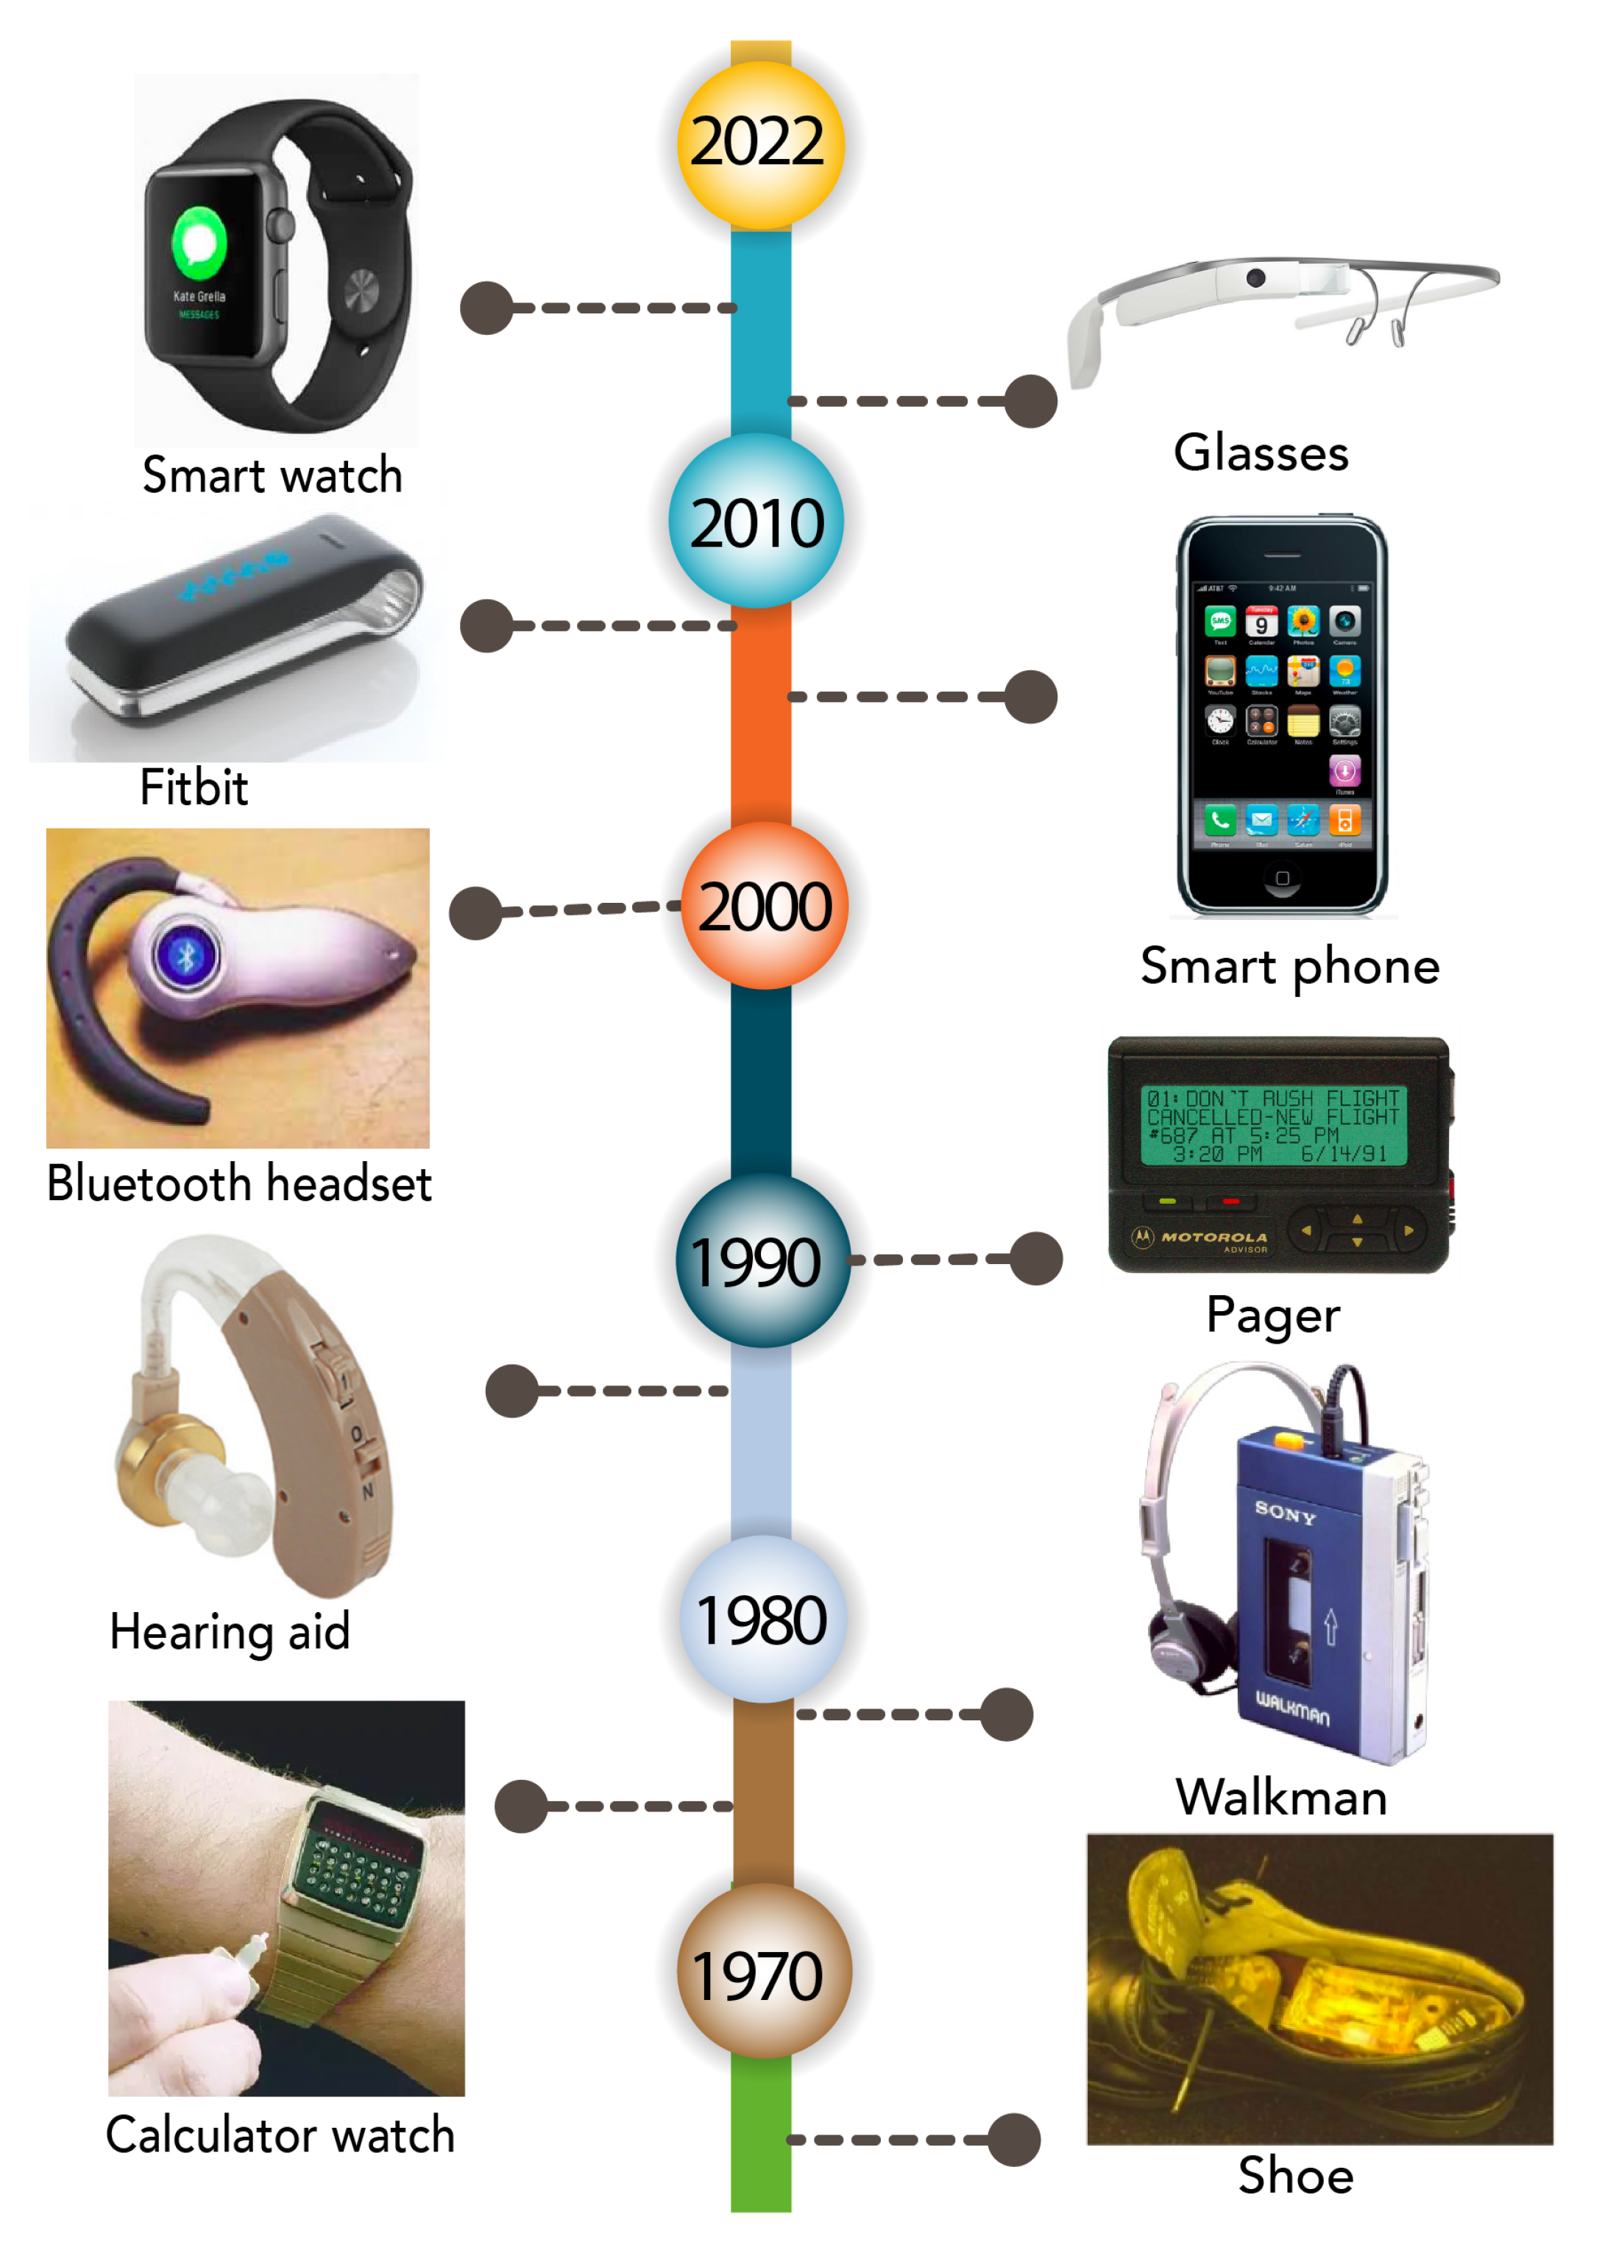

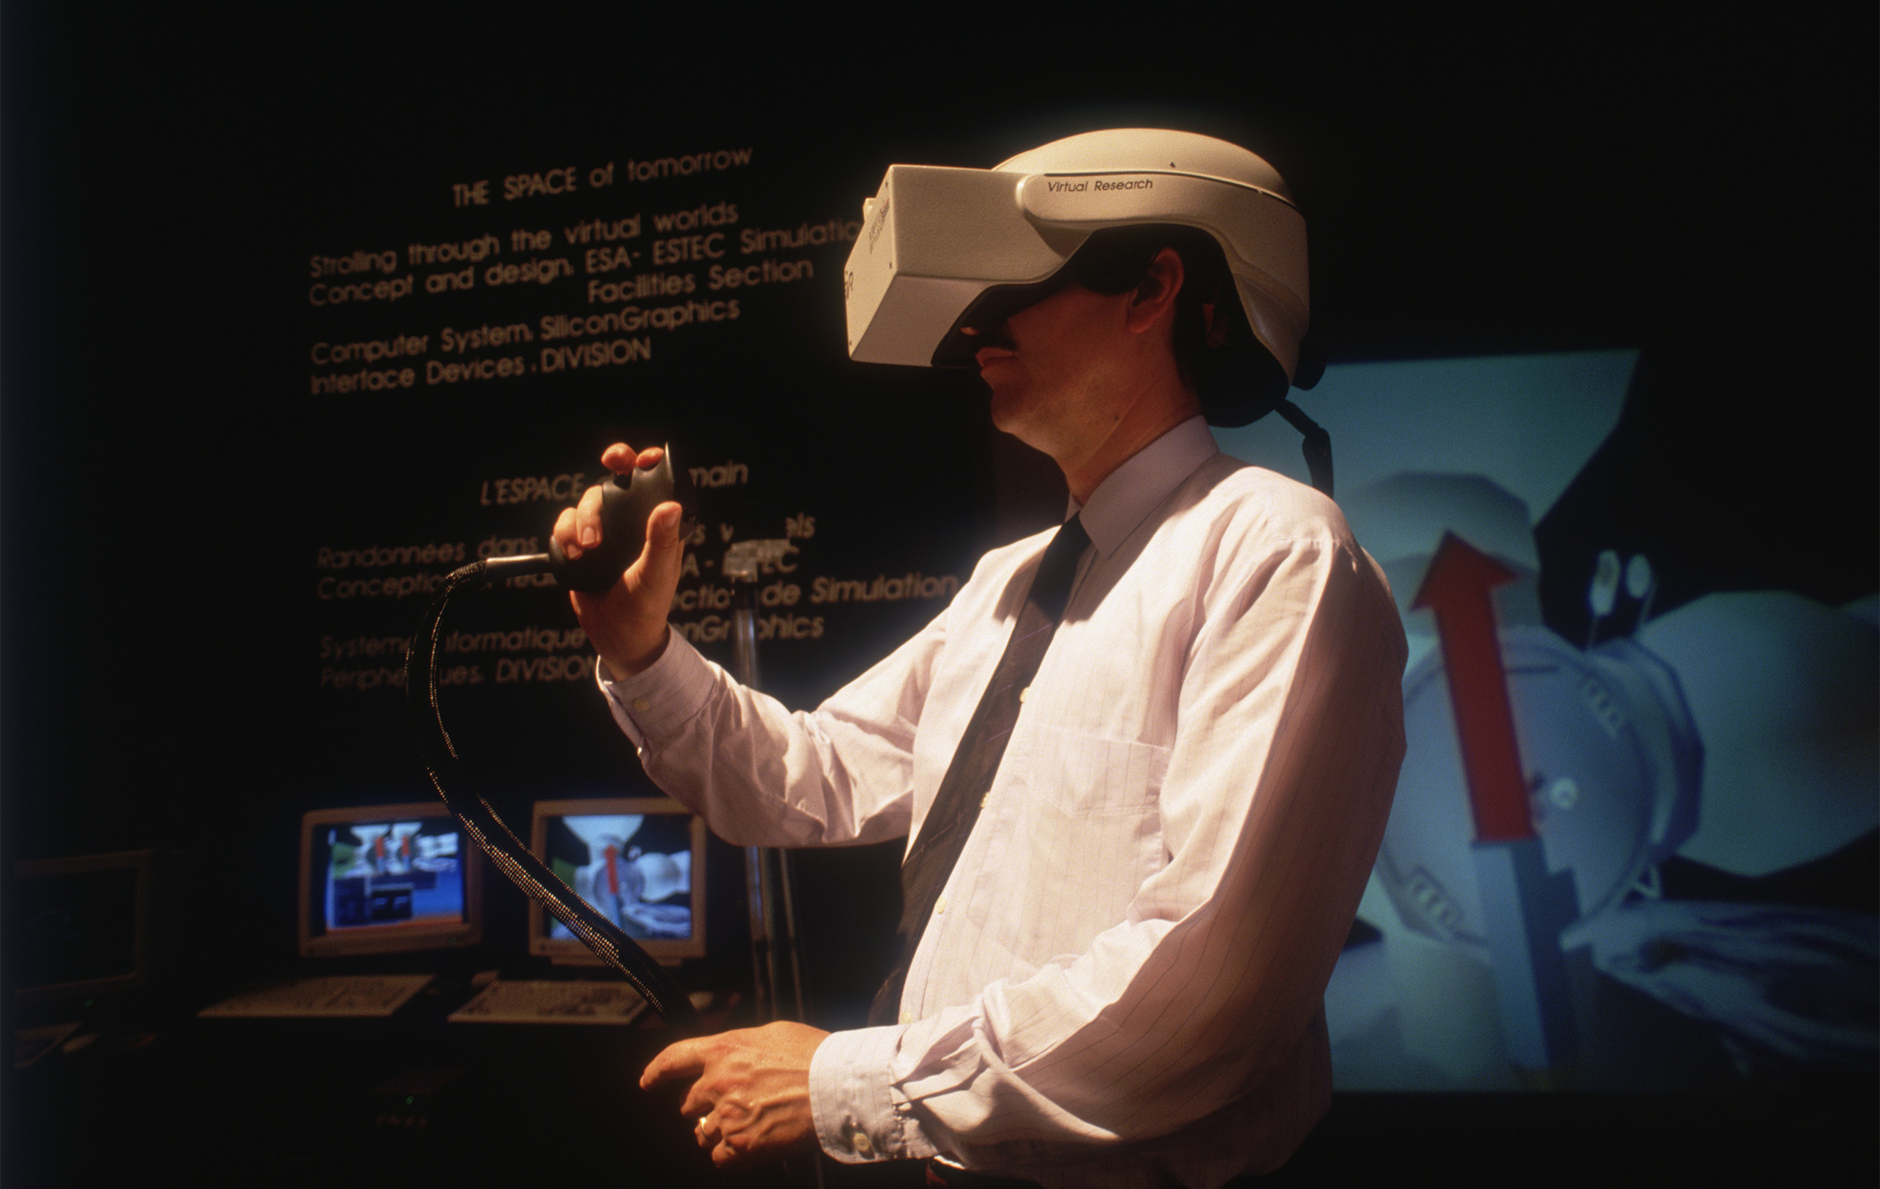
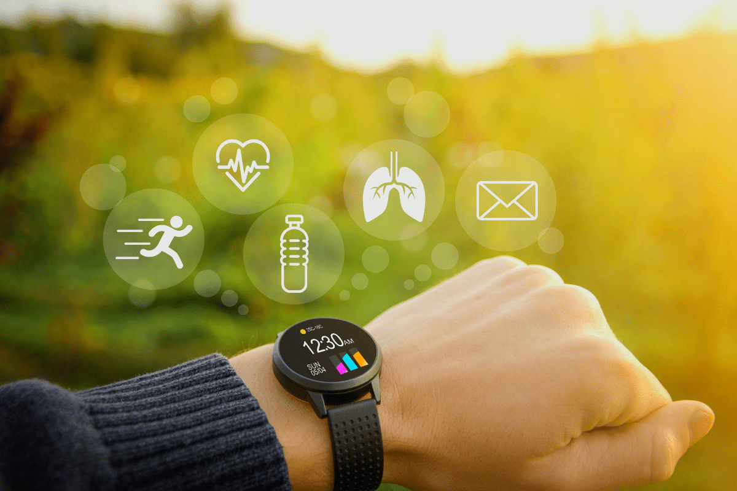
Here’s a concise history of wearable computing:
1500s: The concept of wearable technology began with the invention of the watch, a portable timekeeping device.
1960s: Mathematician Edward Thorp developed the first wearable computer, used to predict outcomes in roulette games.
1980s: Wearable computing advanced with the creation of a computer featuring a head-mounted display.
2010s: The modern era of wearables emerged with the rise of smartwatches and fitness trackers, bringing computing devices into everyday accessories.
PRIVIEW
NEXT
HOME

Slide 7
3.Types of Wearable Computer
PRIVIEW
NEXT
HOME

Slide 8
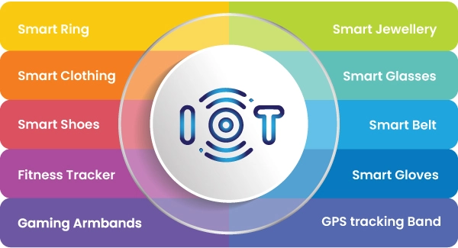
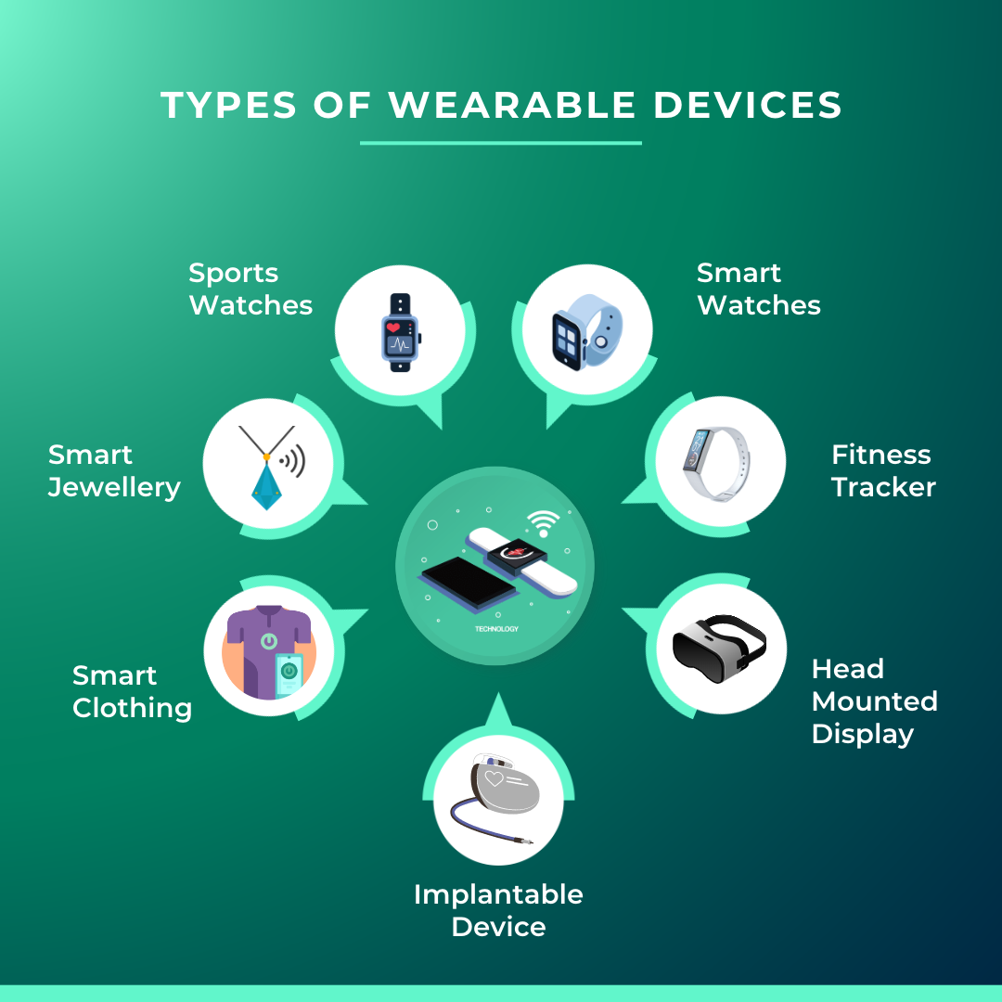
Types of wearable computer
1. Smart Watches
2. Smart Glasses
3. Fitness Tracker
4. Smart Clothing
5. Wearable Headset
6. Wearable Cameras
7. Smart Shoes
PRIVIEW
NEXT
HOME

Slide 9
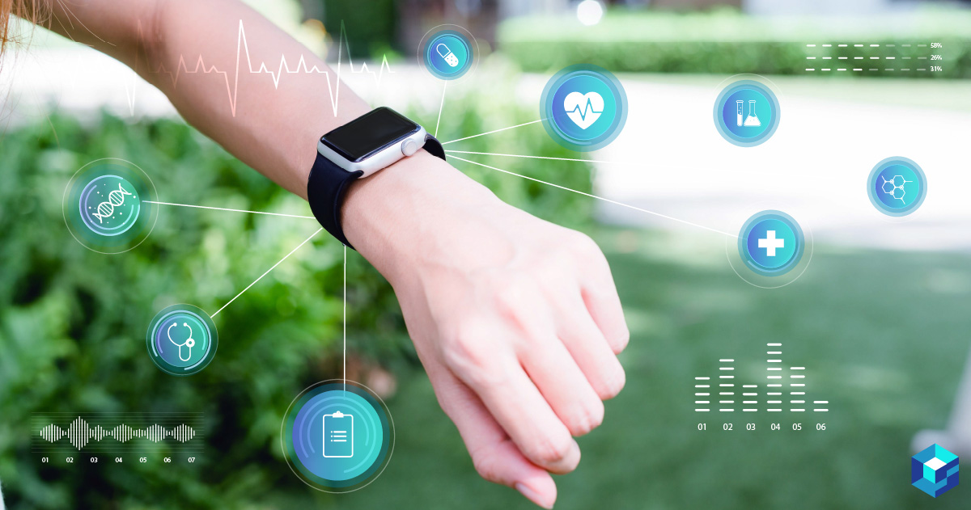
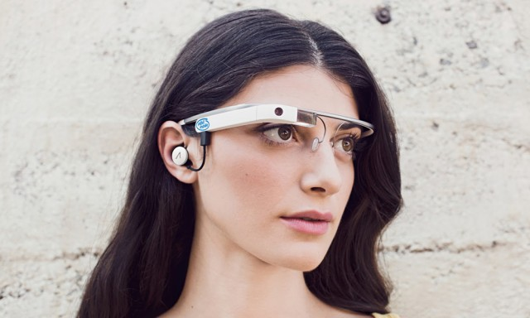
A wearable computer can take many forms, depending on its purpose and design. Here's an overview of how it generally looks:
Smart Watches:
- Timekeeping
-Notification alerts
- Fitness tracking
- Music playback
- Mobile payment
2. Smart Glasses:
- Virtual displays
- Augmented reality experiences
- Voice commands
- Gesture recognition
PRIVIEW
NEXT
HOME

Slide 10
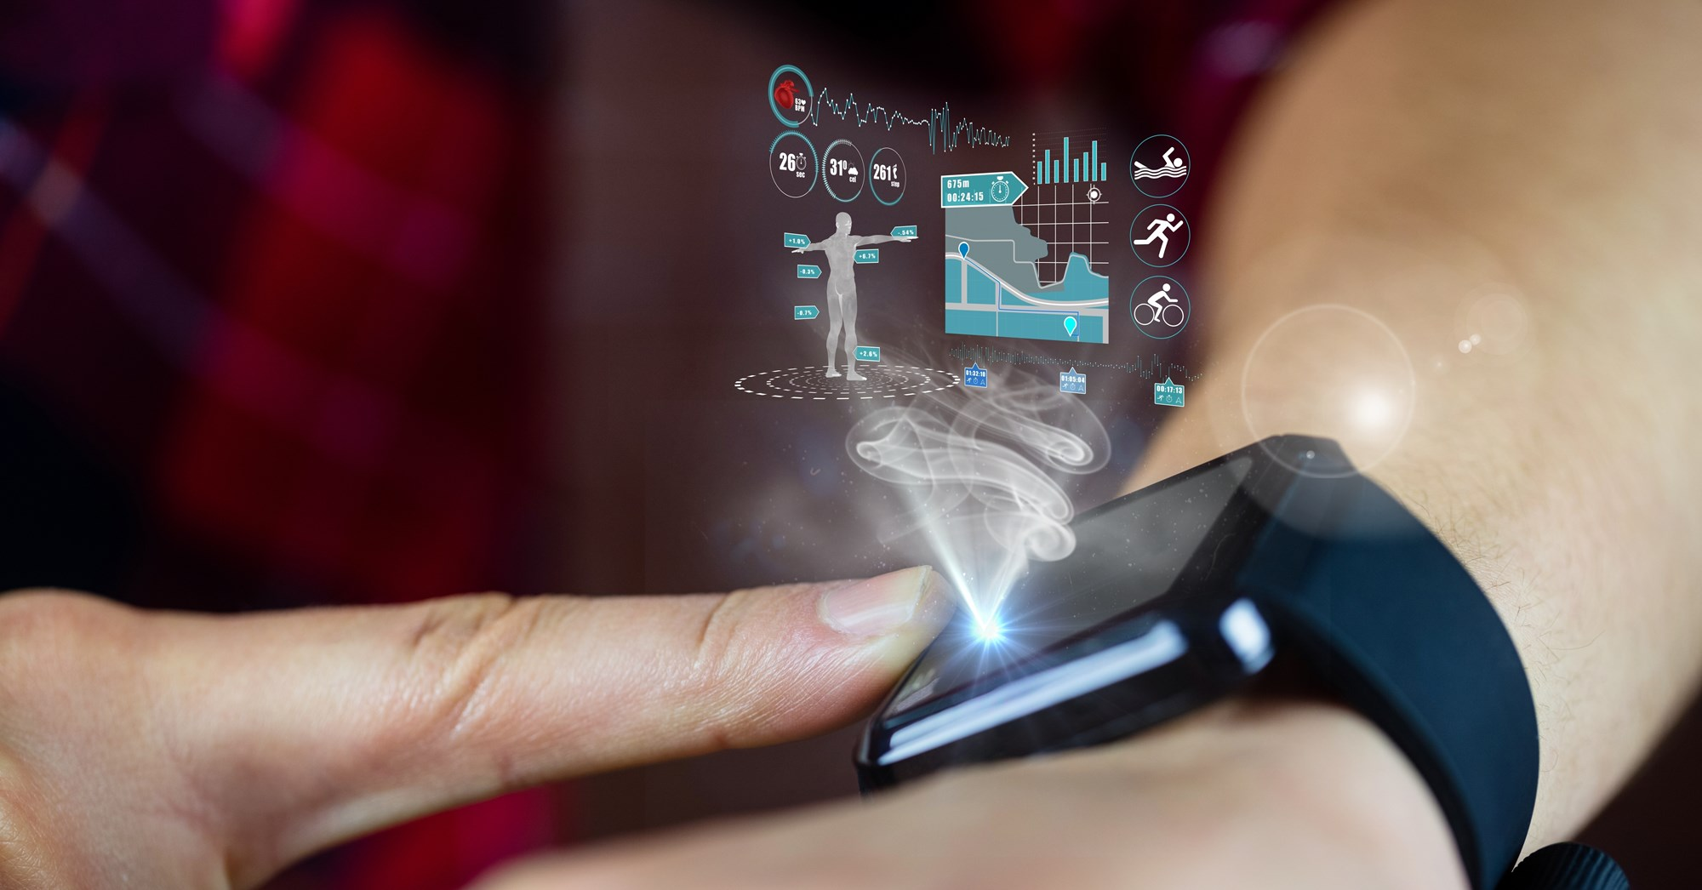
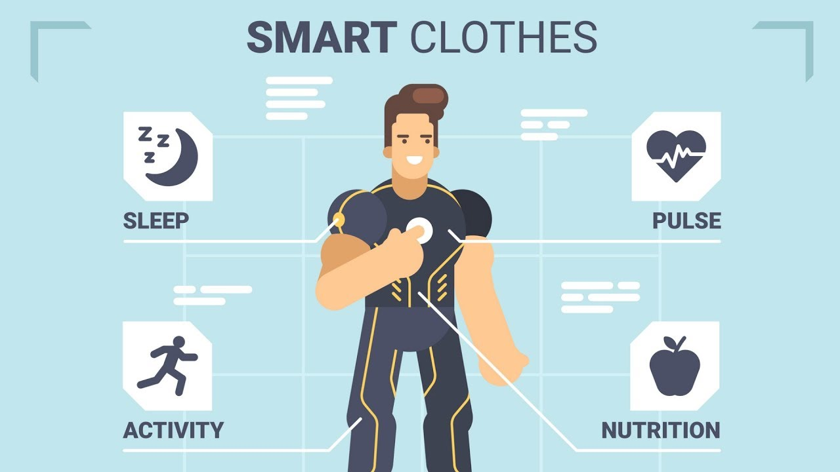
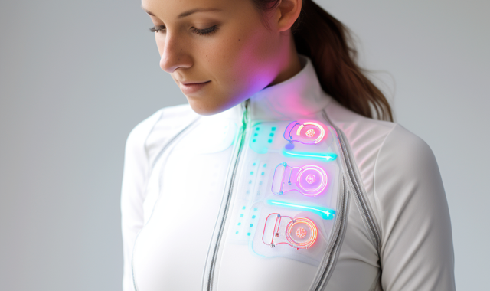
3. Fitness Trackers:
- Step tracking
- Distance tracking
- Calorie burn tracking
- Sleep tracking
- Heart rate monitoring
4. Smart Clothing:
- Fitness tracking
- Biometric monitoring
- Temperature regulation
- Impact protection
PRIVIEW
NEXT
HOME

Slide 11
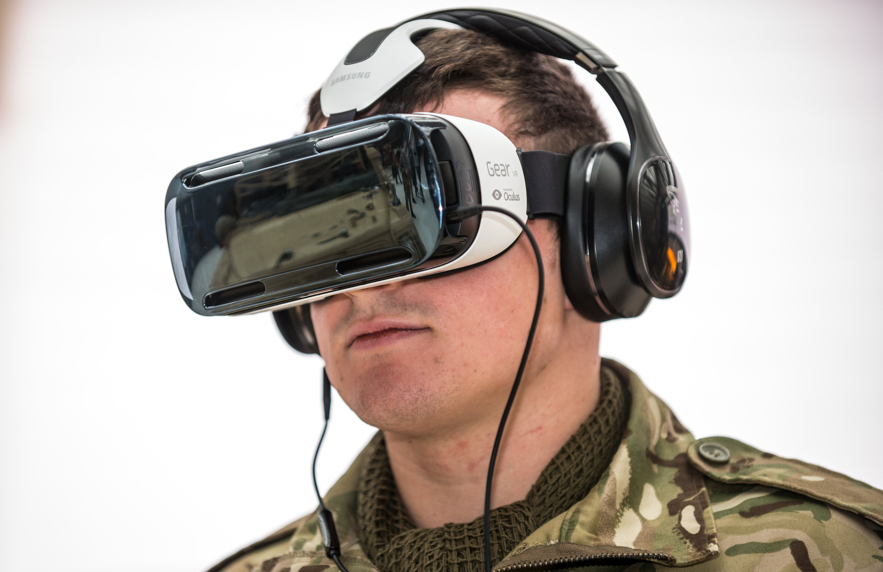
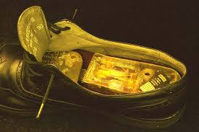
5. Wearable Headsets :
- 360-degree visuals
- Spatial audio
- Motion tracking
- Interactive experiences
6. Smart Shoes:
- Fitness tracking
- Biometric monitoring
- Temperature regulation
- Impact protection
PRIVIEW
NEXT
HOME

Slide 12
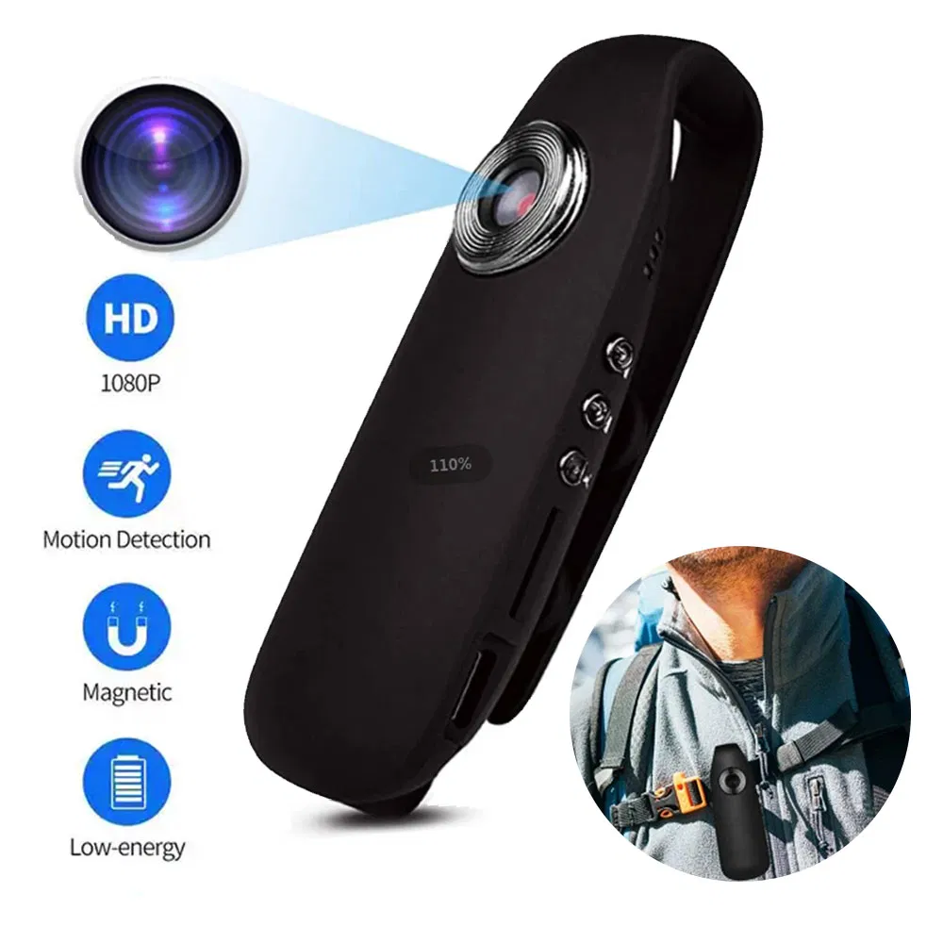
7. Wearable Camera :
- 360-degree visuals
- Spatial audio
- Motion tracking
- Interactive experiences
PRIVIEW
NEXT
HOME

Slide 13
4.Application of Wearable Computer
PRIVIEW
NEXT
HOME

Slide 14
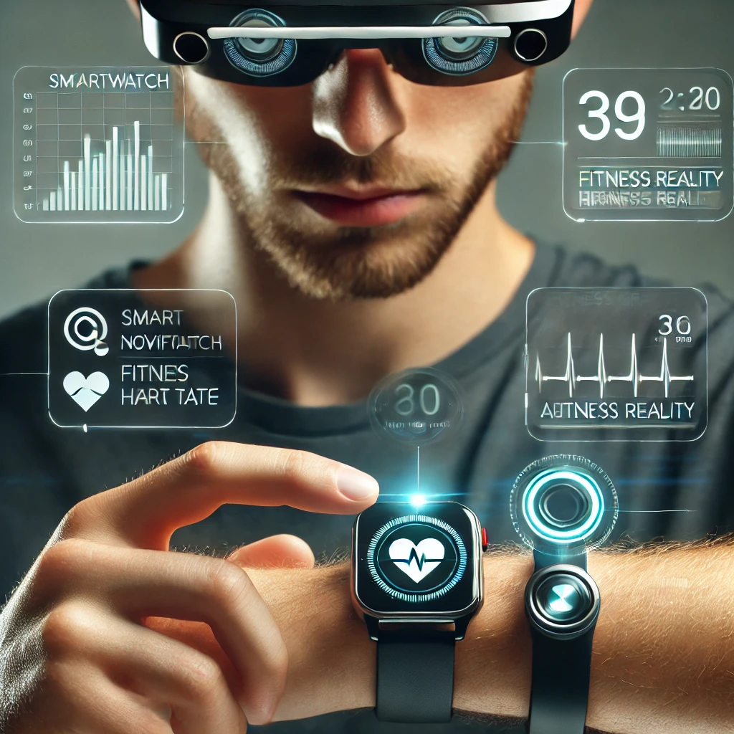
Application of Wearable Computer
1.Health and Fitness
2. Communication
3. Navigation and Transportation
4. Gaming and Entertainment
5. Education and Training
6. Industrial and Enterprise Applications
7. Military and Defense Applications
Other Applications
PRIVIEW
NEXT
HOME

Slide 15
5.How It Works
PRIVIEW
NEXT
HOME

Slide 16
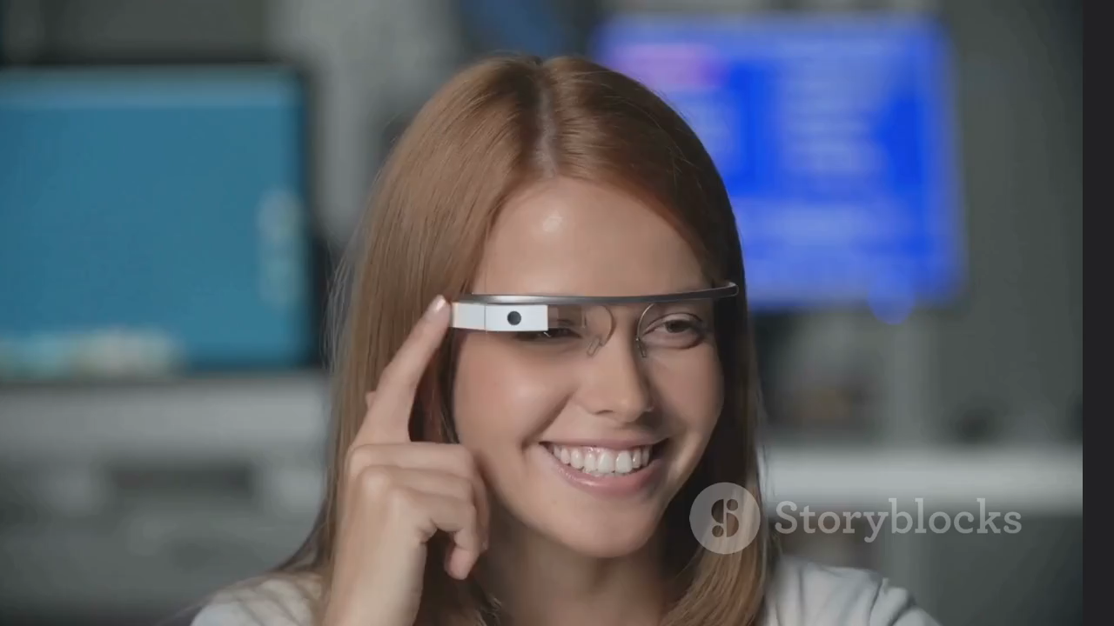
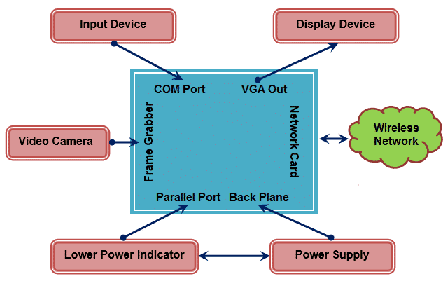
PRIVIEW
NEXT
HOME

Slide 17
6.Aims of Wearable Computer
PRIVIEW
NEXT
HOME

Slide 18
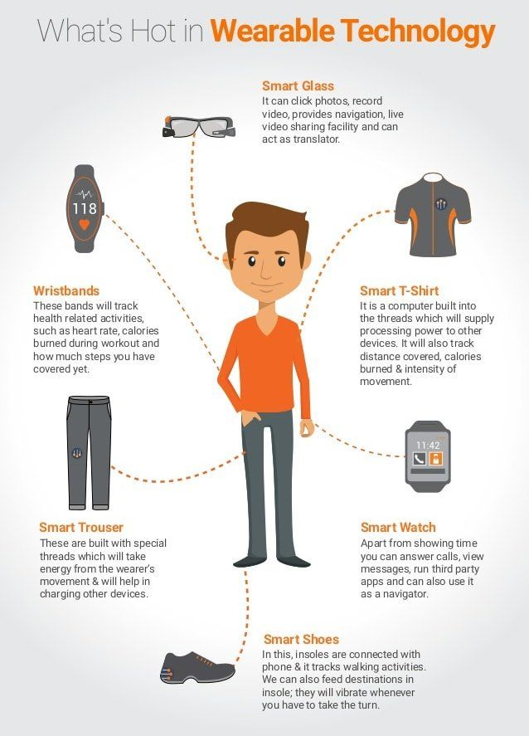
Aims of Wearable Computer
1. Convenience
2. Health and Fitness Tracking
3. Real-Time Information
4. Augmented Reality
5. Personalized Used
6. Improved Productivity
PRIVIEW
NEXT
HOME

Slide 19
7.Advantages &
Disadvantages
PRIVIEW
NEXT
HOME

Slide 20
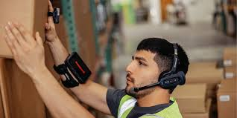
Advantages
Advantages
1.Convenience
2. Hands-Free Operation
3. Health Monitoring
4. Real-Time Notifications
5. Enhanced Mobility
6. Personalization
PRIVIEW
NEXT
HOME

Slide 21
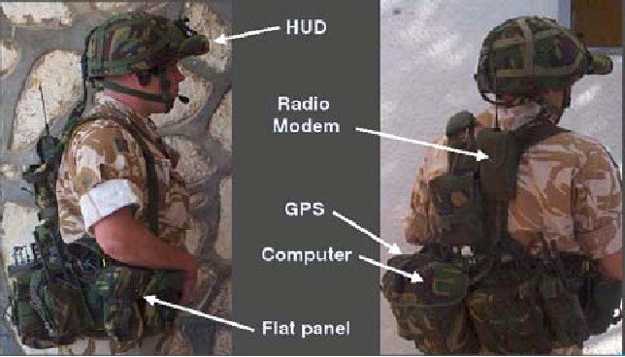
Dis-Advantages
Disadvantages
1. Limited Battery Life
2. Small Screen Size
3. Privacy Isaue
5. Durability Issues
6. Dependence on Other Devices
4. Cost
PRIVIEW
NEXT
HOME

Slide 22
8.Features of Wearable Computer
PRIVIEW
NEXT
HOME

Slide 23
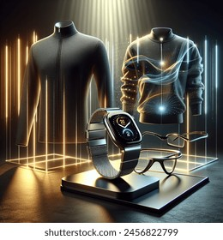
Features of Wearable Computer
1. Portability and Compact Design
2. Hands-Free Operation
3. Real-Time Data Processing
4. Sensors and Monitoring
5. Low Power Consumption
6. Water Resistance
PRIVIEW
NEXT
HOME

Slide 24
Conclusion
Wearable computers bring computing power into devices worn on the body, allowing hands-free access to information.
Starting with Edward Thorp's 1960s invention, they have evolved into modern smartwatches and fitness trackers that enhance everyday life.
As the field advances, wearable computers are making interactions with technology more intuitive and accessible.
PRIVIEW
NEXT
HOME

Slide 25
Reference Sites
https://en.wikipedia.org/wiki/Wearable_computer
https://www.geeksforgeeks.org/what-is-wearable-computers/
https://www.researchgate.net/publication/306322945_Wearable_Computing_and_its_Application
PRIVIEW
NEXT
HOME

Slide 26
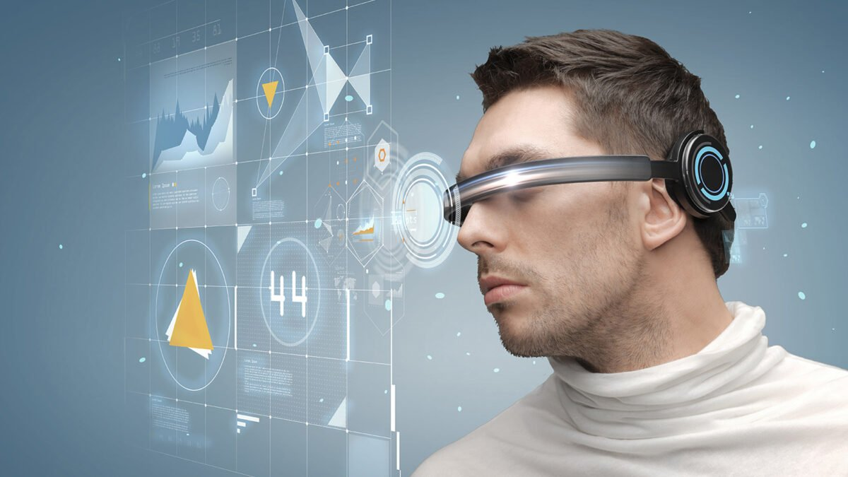
Thank you

